Slide 1
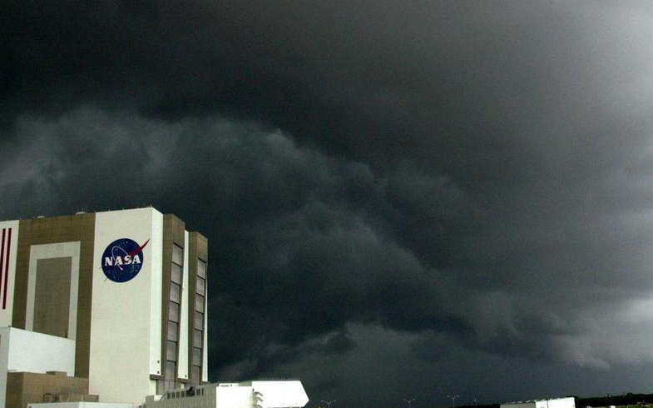
Will It Rain On My Parade ?
Challenge : NASA Space Apps Challenge 2025 - Challenge#18
Team Name : CelestiaX
Team Members :Don Joseph
Ben Sebastian Joseph
Joel Davis
Aleesha Maria Mathew
Anushma Prasad
Sania Sen

Slide 2
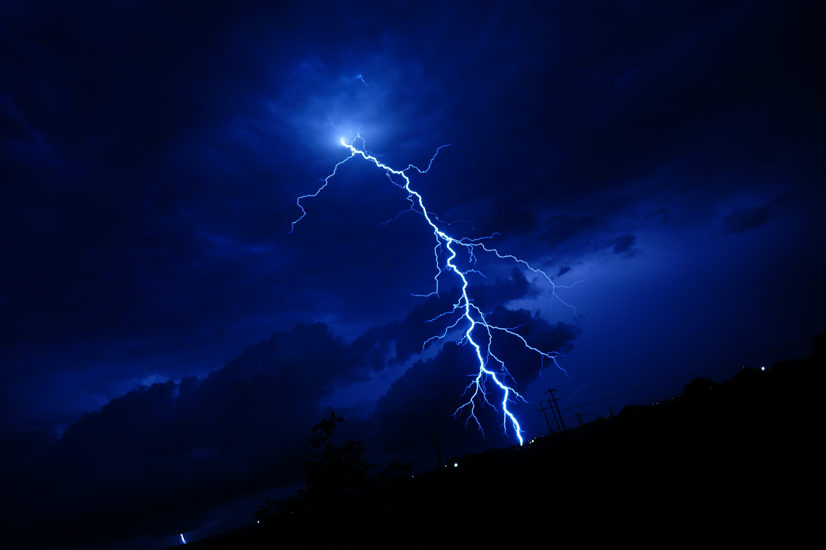
Problem Statement
Outdoor events often face unexpected weather disruptions.
Predicting rain and weather conditions for specific times and places is difficult for the public.
Goal: Help users plan events smarter using NASA Earth observation data and live weather APIs.

Slide 3
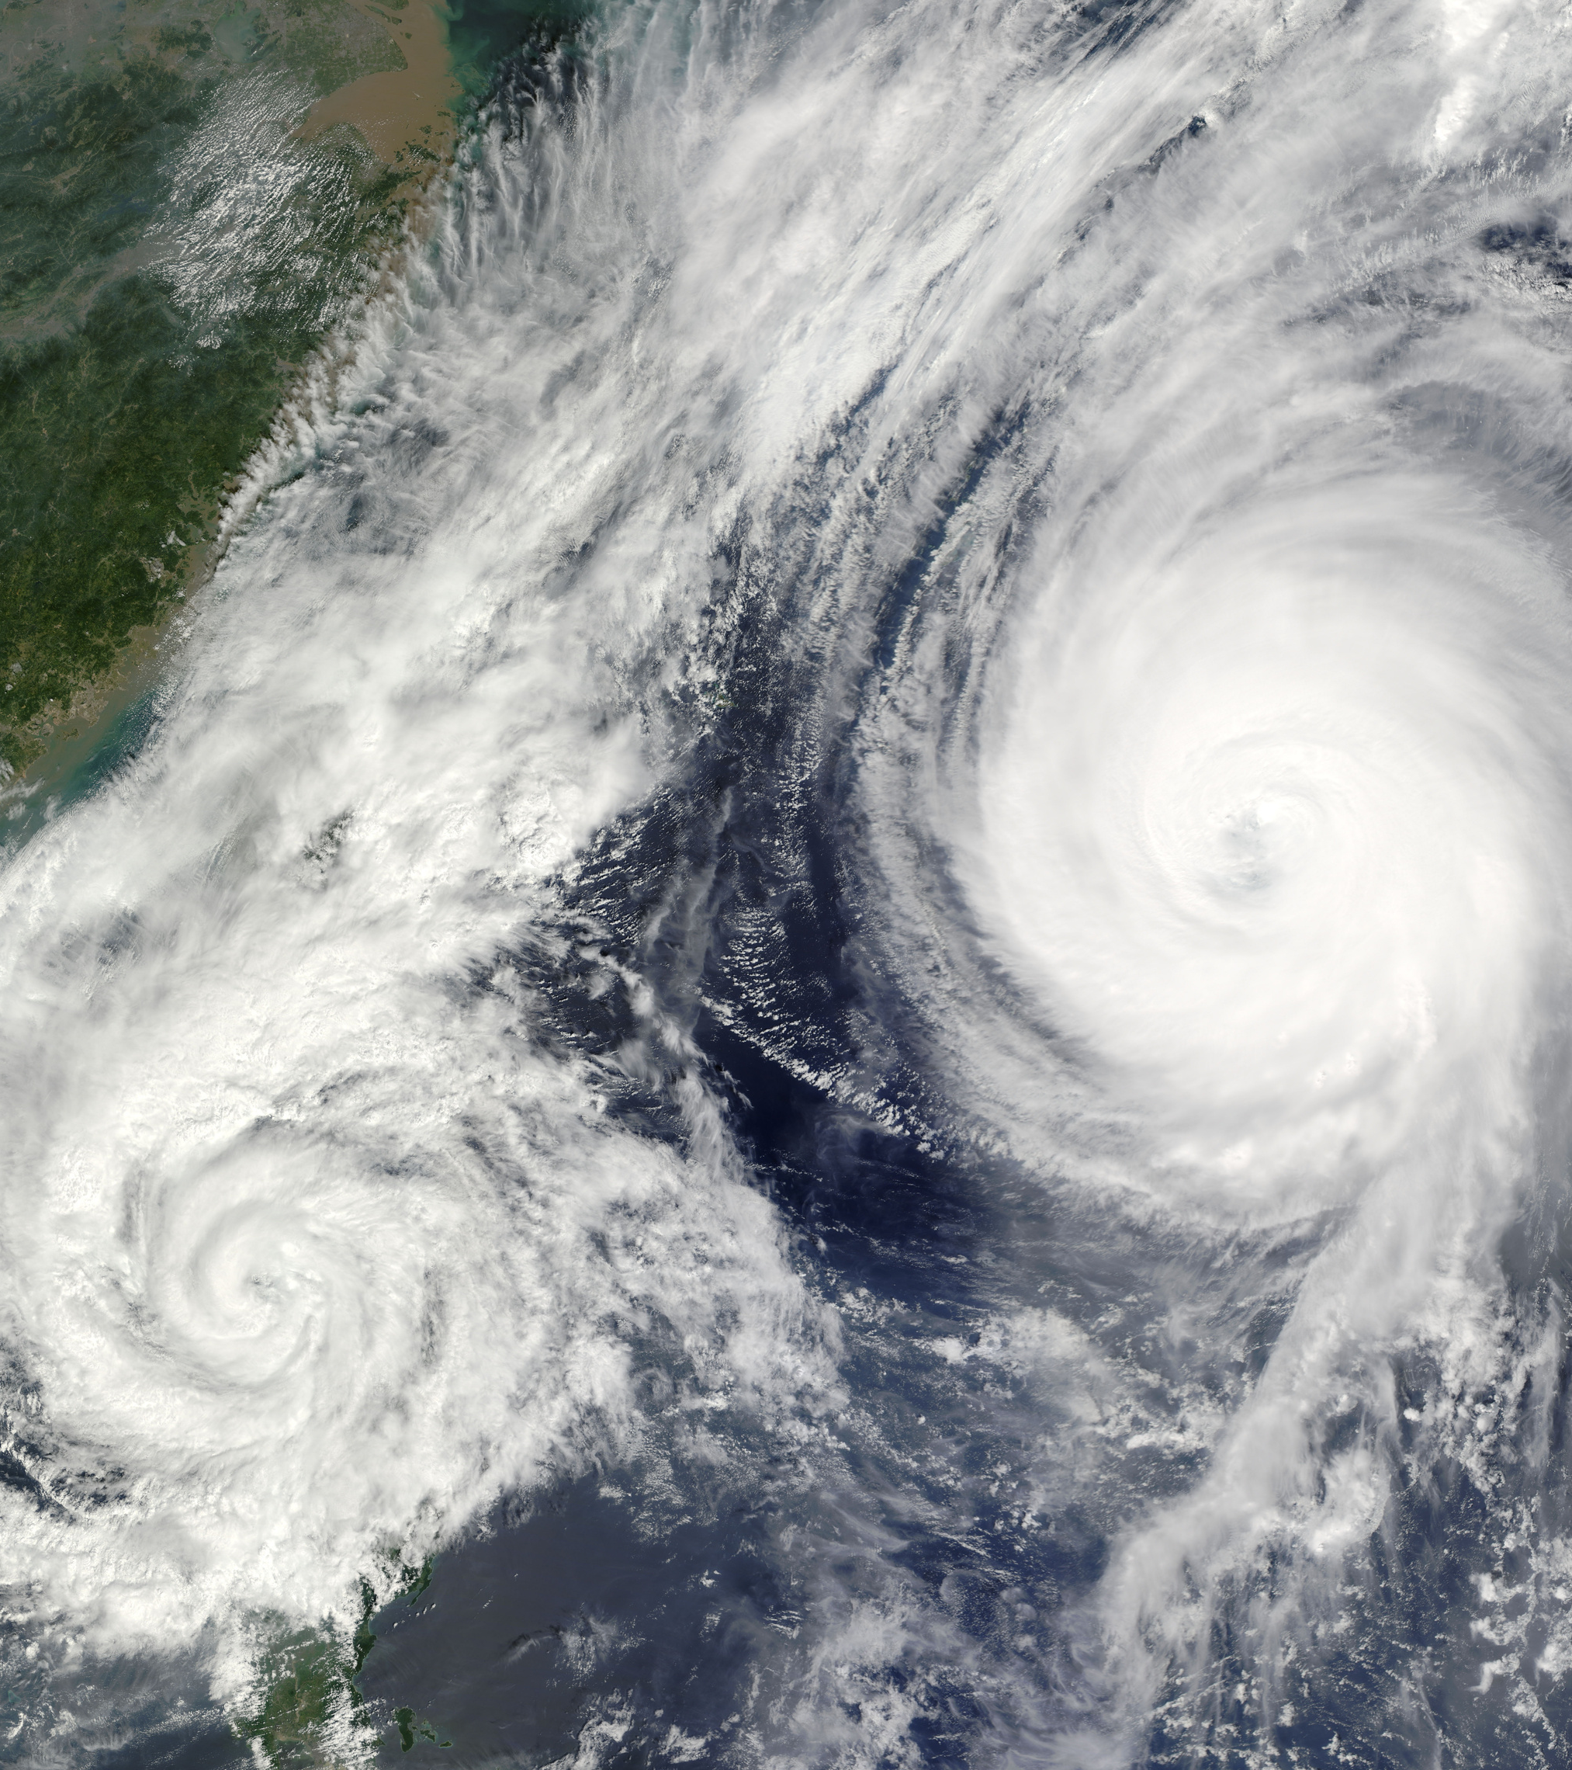
Solution Overview
A web app that predicts rain and weather conditions for any date and location.
Uses NASA Earth Science data for high-accuracy forecasts.
Personalized dashboard with details like temperature, precipitation, wind speed, and air quality.

Slide 4
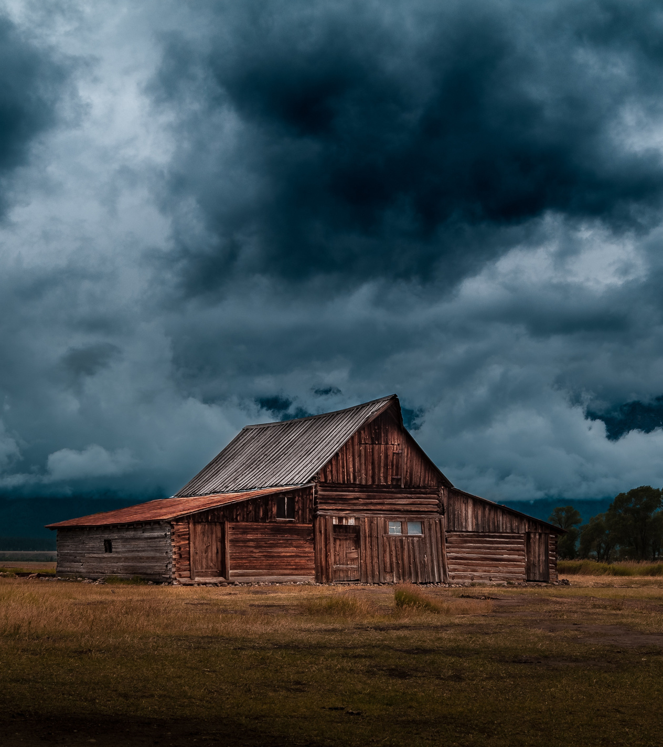
How it Works
Heading: Workflow & Technology Content:
User enters date and location.
App fetches NASA Earth observation and live weather data.
Backend processes and predicts rain probability.
Dashboard displays detailed results.

Slide 5
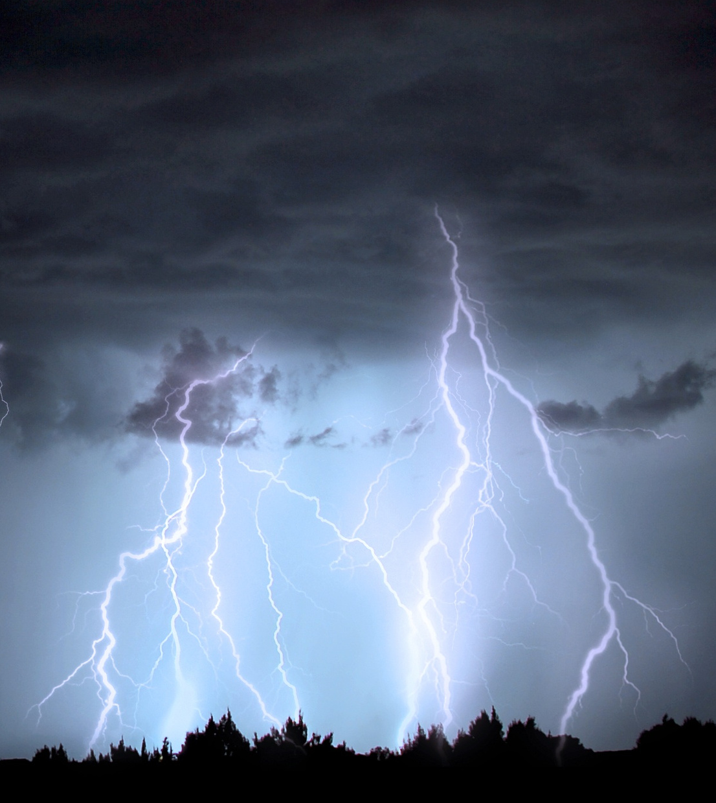
Technology Stack
Programming / Frameworks: Python, Flask
Frontend / UI: HTML, CSS, JavaScript
Data & APIs: NASA Open APIs (e.g., Earthdata, Satellite imagery)
Database / Storage: Firebase / SQLite
AI & ML: TensorFlow / Scikit-learn (for model or image analysis)
Visualization: Matplotlib / Plotly
Collaboration & Deployment: GitHub, Google Colab, Render / Vercel

Slide 6
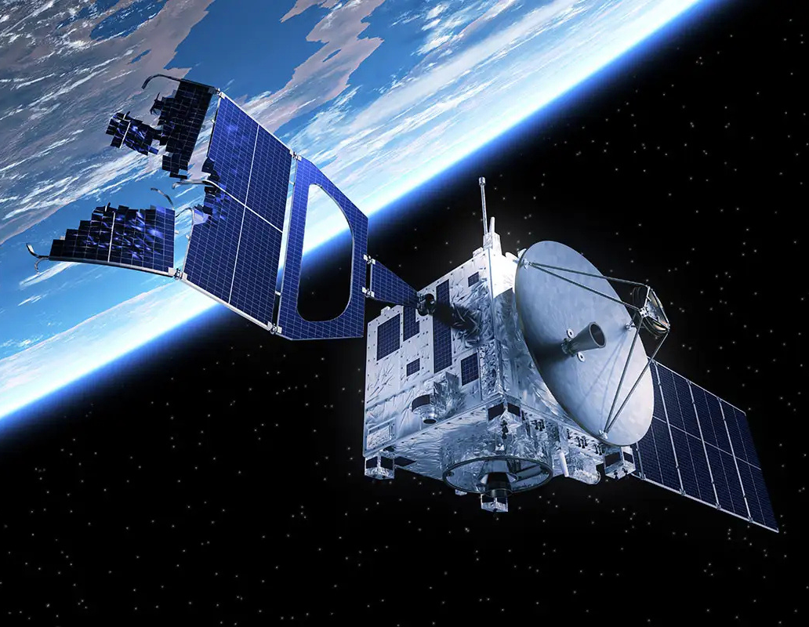
NASA Data And Impact
NASA POWER API provides accurate global atmospheric and precipitation data.
Enables precise rain prediction and environmental awareness.
Demonstrates the use of open NASA data for public benefit.

Slide 7

Results & Future Scope
Built a working prototype in 36 hours.
Integrated live weather and NASA APIs.
Delivered a user-friendly experience with visualized insights.
Future Enhancements:
Mobile app version and push notifications.
ML-based rain prediction for longer-term accuracy.
Collaboration with event planners for safety alerts.
THANK YOU

